Slide 1
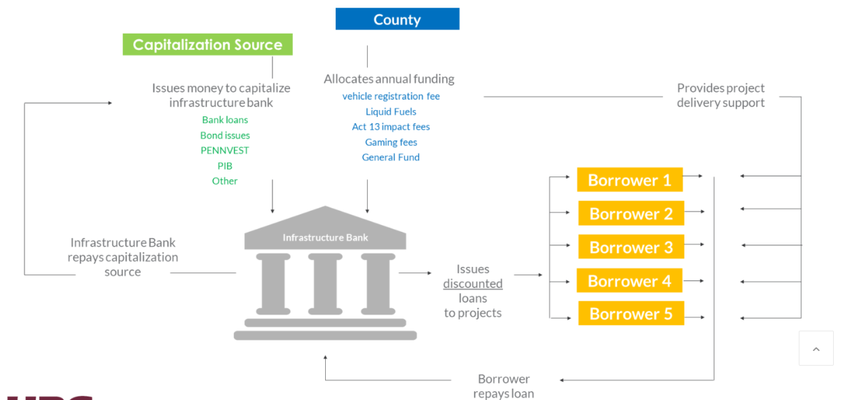

Slide 2
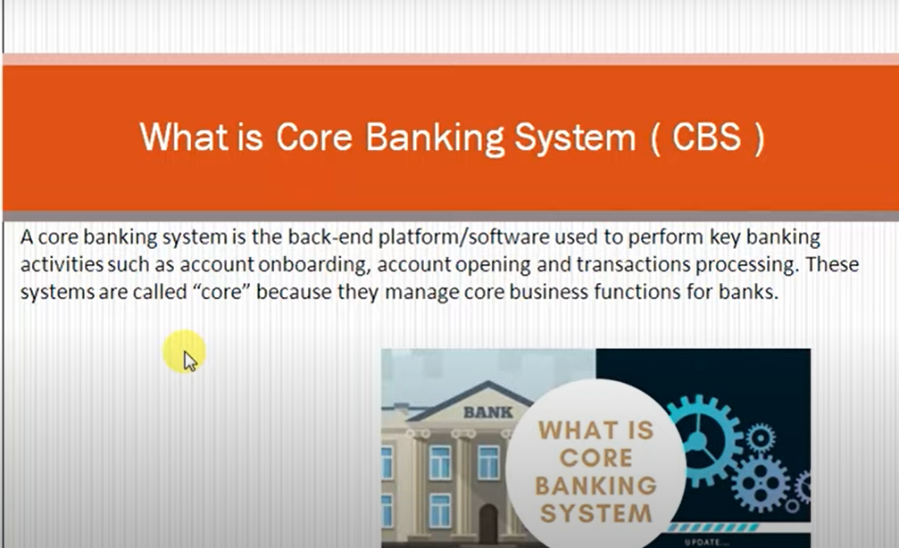

Slide 3
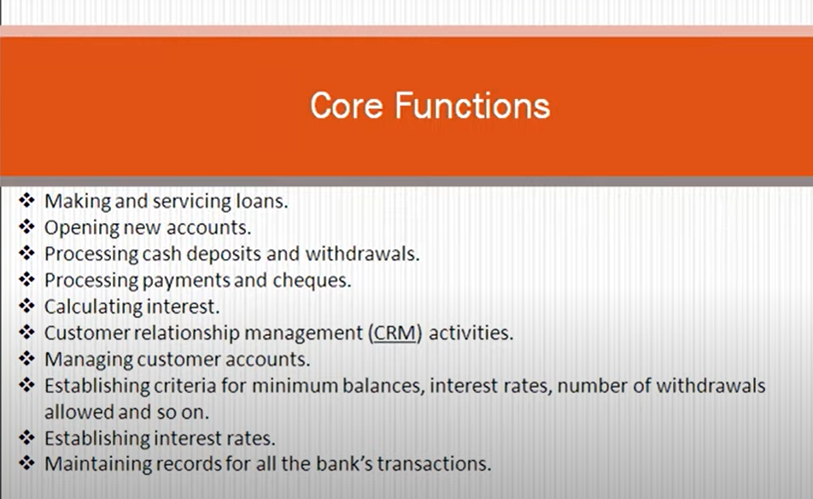

Slide 4
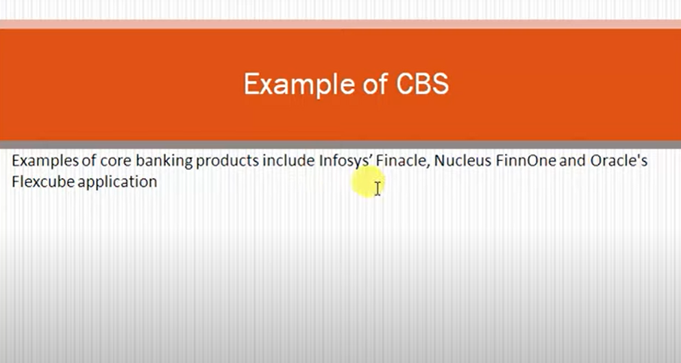

Slide 5
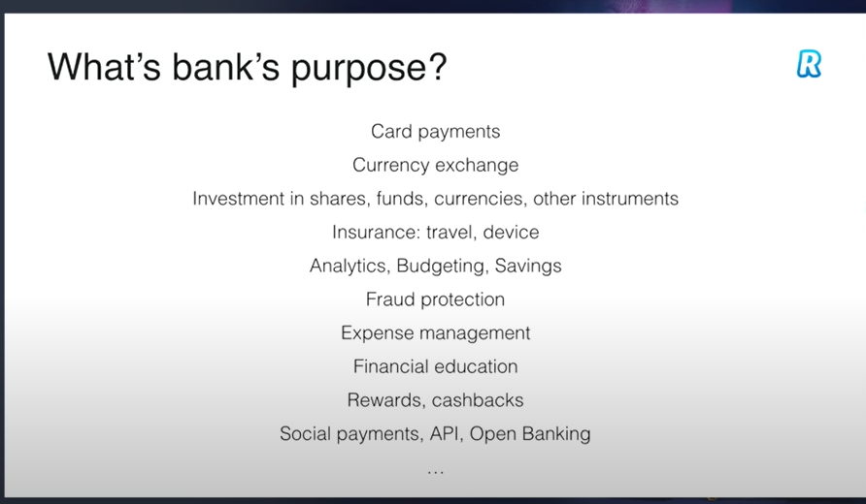

Slide 6
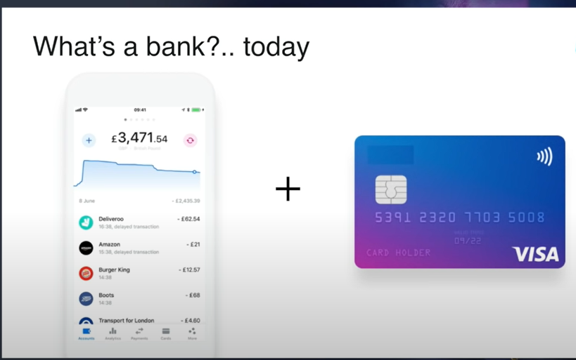
Previous days it was like a…..big buildings and physical visit But Nowadays ….home delivery cards and digital access something

Slide 7
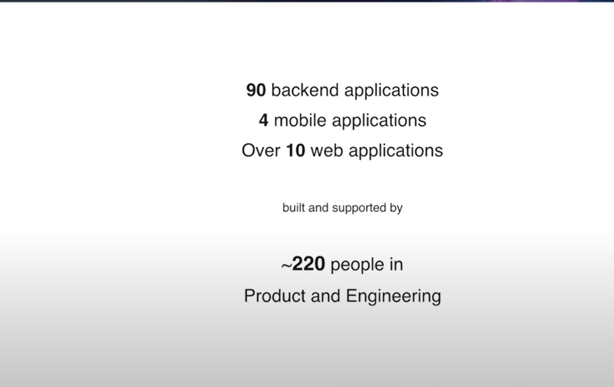
Mobile applications-like ios-android applications-retail and business Web applications-for use internal

Slide 8
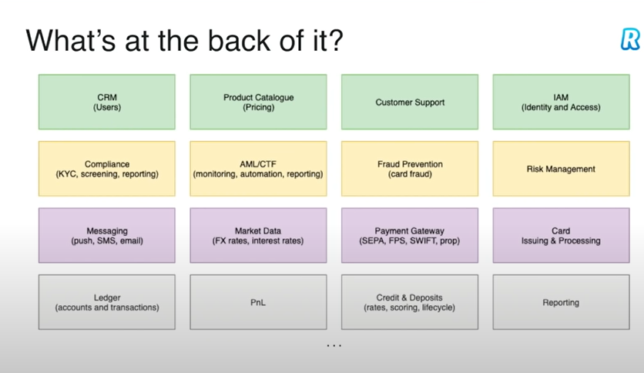
Bankend
Backend bellow all will work

Slide 9
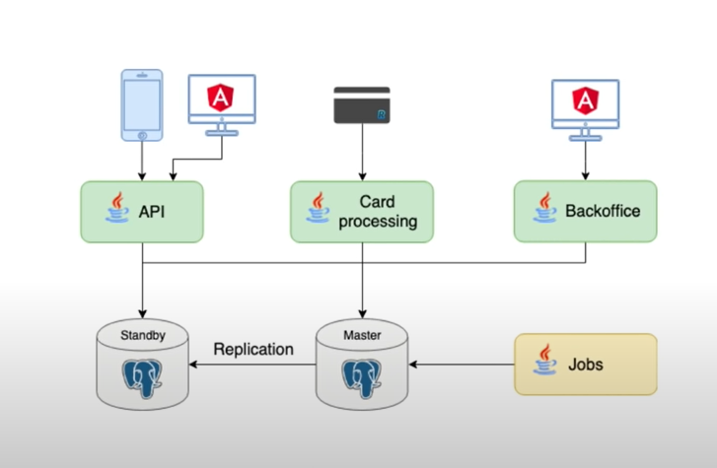
Monolithic drow-API is like one click transaction users and card processing –this all data stores in storage like-SQL,MYSQL,Postgress…(maintaining standby aswell) -Lot’s of staff is going on backend for a simple transaction

Slide 10
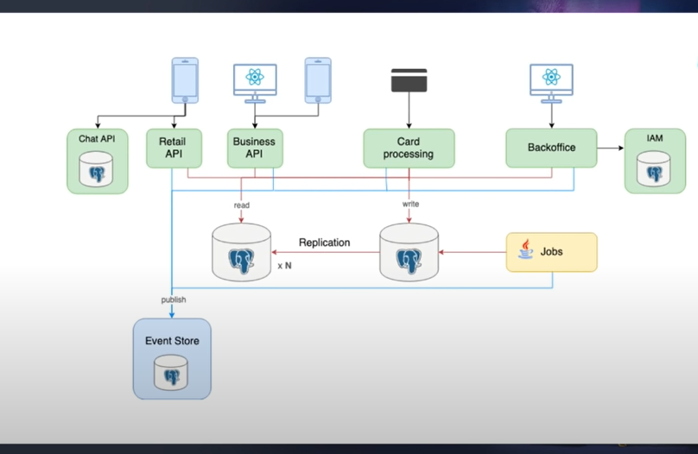

Slide 11
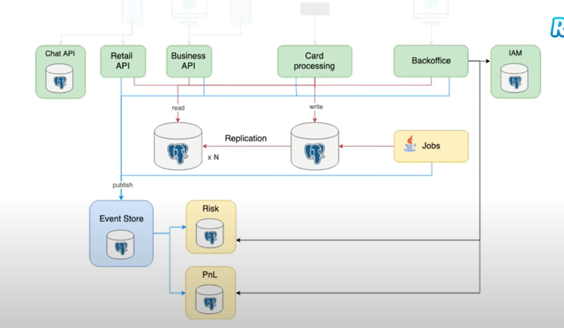

Slide 12
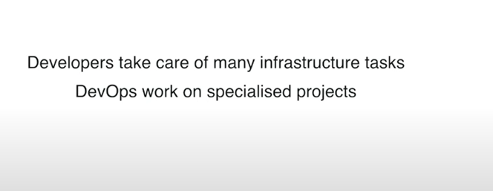
Pipelines-Some business analist,requirements,developers-coding,testing and release management-agile as well

Slide 13
